Slide 1
Feature Selection and Extraction
Citizen Analytics – An Initiative by Data Science Team
S T A R T
Internal

Slide 2
Learning Objectives
By the end of this module, you will be able to:
01
Identify available techniques for feature selection and feature extraction.
02
Perform feature selection in Azure ML.
03
Perform feature extraction in Azure ML.
Internal

Slide 3
Content
01.
02.
Feature Selection
Pearson correlation
Chi-squared Test
Spearman Correlation
Kendall Correlation
Feature Extraction
Linear Discriminant Analysis
04
17
Internal

Slide 4
Feature Selection
Internal

Slide 5
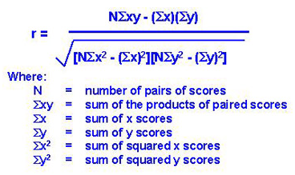
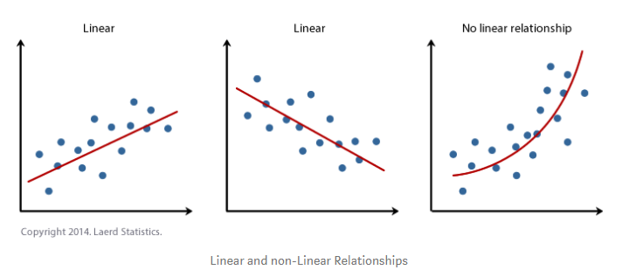
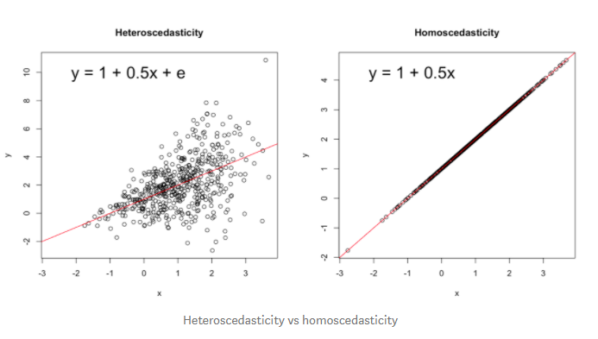
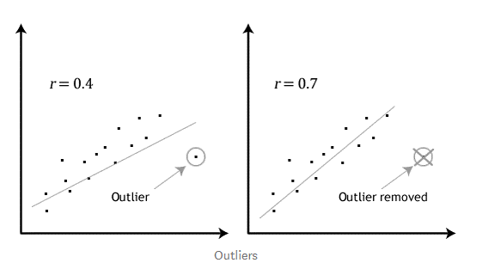
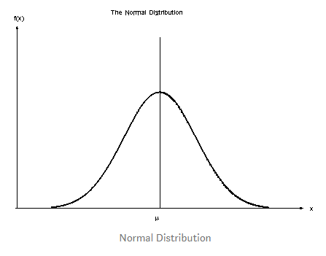
Feature Selection - Pearson correlation
Pearson correlation coefficient is a measure of the strength of a linear association between two variables — denoted by r.
Assumptions:
Each variable should be continuous i.e. interval or ratios for example weight, time, height, age etc.
The observations are paired observations. That is, for every observation of the independent variable, there must be a corresponding observation of the dependent variable.
5. The two variables have a linear relationship.
3. Homoscedascity means ‘equal variances’. In scatter-plot, if the points lie equally on both sides of the line of best fit, then the data is homoscedastic.
4. No significant outliers. Pearson’s correlation coefficient, r, is very sensitive to outliers, which can have a huge effect on the line of best fit.
6. Both variables should be normally distributed.
Internal

Slide 6
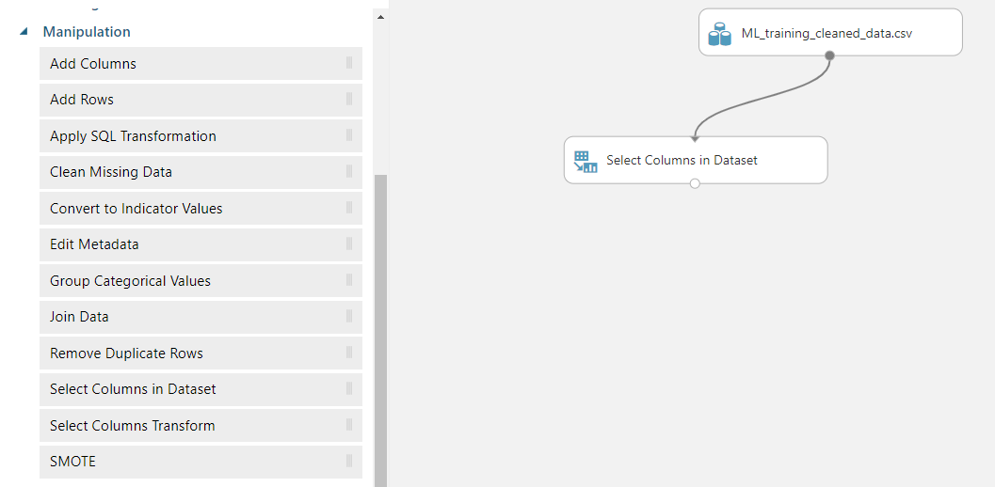
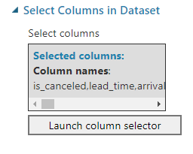
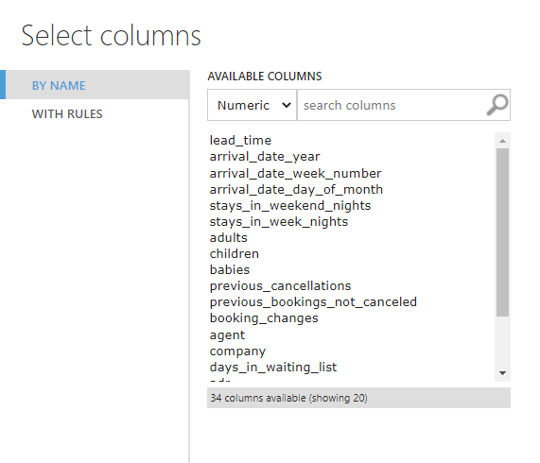
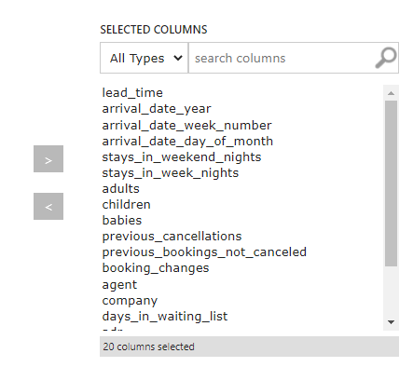
Feature Selection - Pearson correlation
Connect input data to Select Columns in Dataset module.
Include only numeric columns as shown in diagram on the right.
Include also “is_canceled” to be used as Target Column.
Rejoin the columns later using Add Columns if required. The original order of rows is preserved.
Select Numeric Columns
Internal

Slide 7
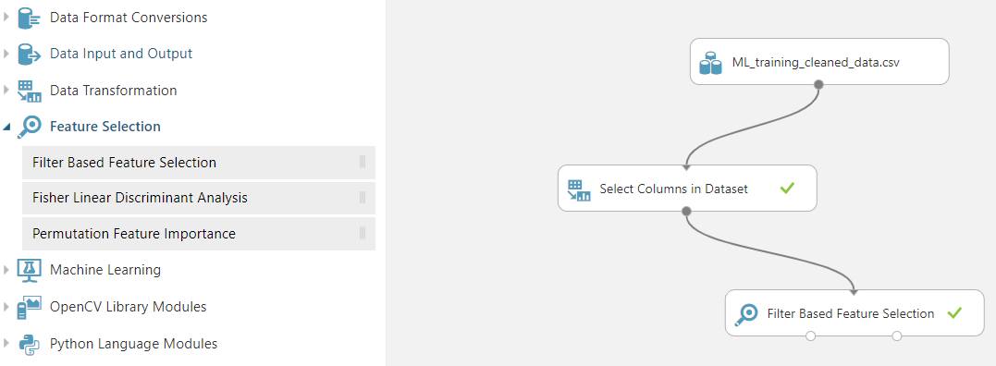
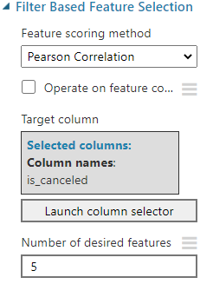
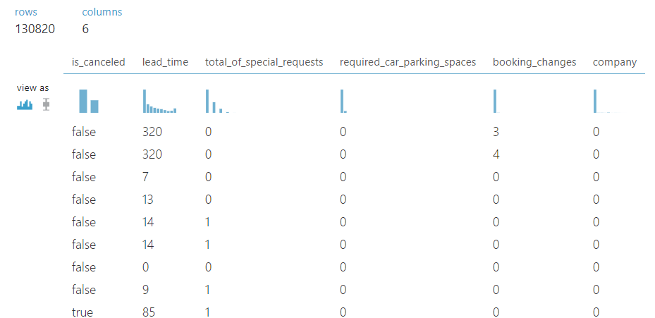
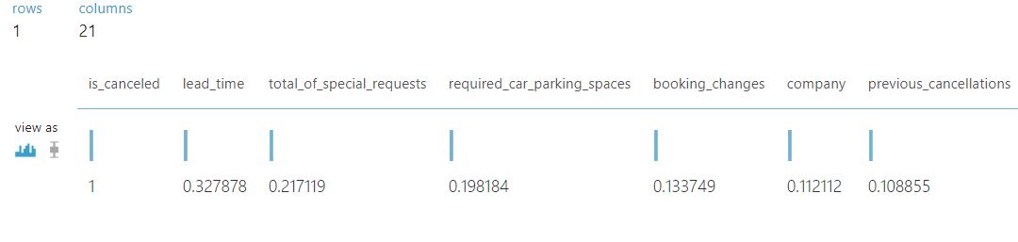
Feature Selection - Pearson correlation
Connect to Filter Based Feature Selection module.
Select Pearson Correlation as Feature Scoring Method.
Click Launch column selector and choose one label as Target column, for example, “is_canceled”.
Type the number of columns for several desired features to indicate number of resultant features desired. For example, “5” :
If the specified number of desired features is greater than the number of columns in the dataset; then all features are returned, even those with zero scores.
If specify fewer result columns than there are feature columns, the features are ranked by descending score, and only the top features are returned.
Run the experiment and visualize results:
Returned dataset with Top 5 features based on descending coefficient.
Coefficient of all features with Target column.
Execute Pearson correlation
Coefficient of all features with target, higher the better.
Dataset with top 5 features highly correlated to target
Internal

Slide 8
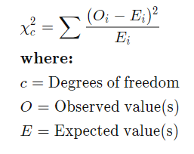
Feature Selection - Chi-squared Test
A chi-squared (χ2) statistic is a test that measures how expectations compare to actual observed data (or model results)
The data used in calculating a chi-square statistic must be random, raw, mutually exclusive, drawn from independent variables, and drawn from a large enough sample. For example, the results of tossing a coin 100 times meet these criteria.
Chi-square tests are often used in hypothesis testing with the formula:
There are two main kinds of chi-square tests: the test of independence, which asks a question of relationship, such as, "Is there a relationship between gender and exam scores?"; and the goodness-of-fit test, which asks something like "If a coin is tossed 100 times, will it come up heads 50 times and tails 50 times?"
A chi-square statistic is one way to show a relationship between two categorical variables. In statistics, there are two types of variables: numerical (countable) variables and non-numerical (categorical) variables. A chi-squared statistic is a single number that tells you how much difference exists between your observed counts and the counts you would expect if there were no relationship at all in the population.
Internal

Slide 9
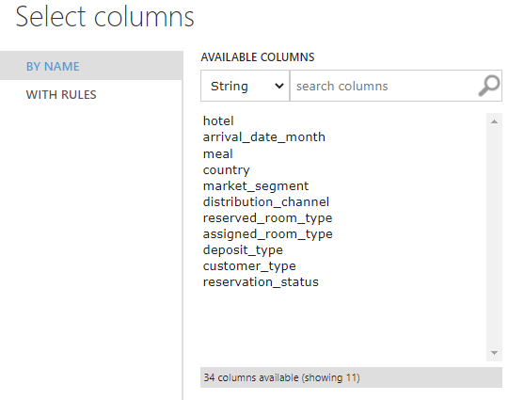
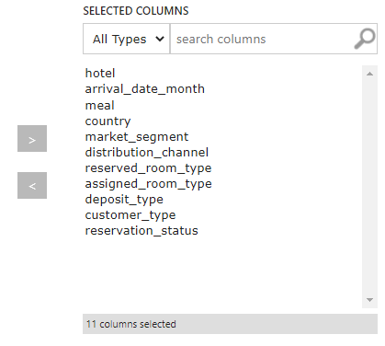
Feature Selection - Chi-squared Test
Connect input data to Select Columns in Dataset module.
Include only string columns as shown in diagram on the right.
Include also “is_canceled” to be used as Target Column.
Rejoin the columns later using Add Columns if required. The original order of rows is preserved.
Select Categorical Columns
Internal

Slide 10
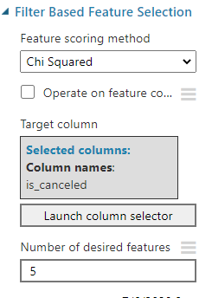
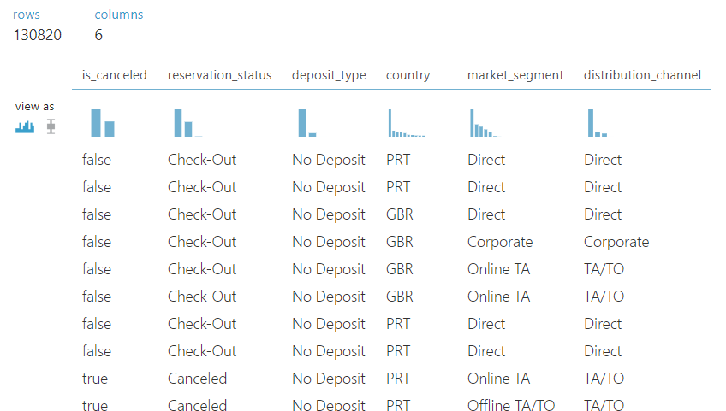
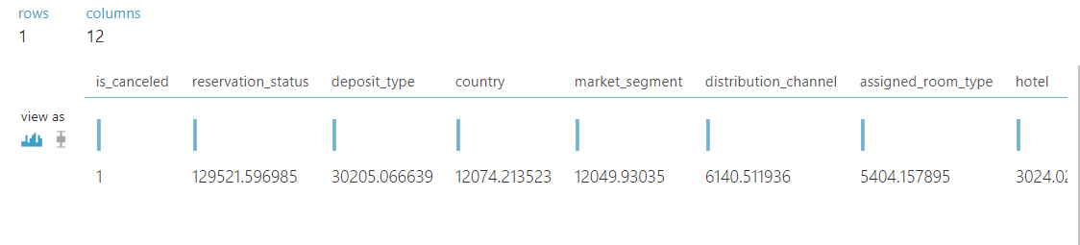
Feature Selection - Chi-squared Test
Connect to Filter Based Feature Selection module.
Select Chi-squared as Feature Scoring Method.
Click Launch column selector and choose one label as Target column, for example, “is_canceled”.
Type the number of columns for Number of desired features to indicate number of resultant features desired. For example, “5” :
If the specified number of desired features is greater than the number of columns in the dataset; then all features are returned, even those with zero scores.
If specify fewer result columns than there are feature columns, the features are ranked by descending score, and only the top features are returned.
Run the experiment and visualize results:
Returned dataset with Top 5 features based on descending coefficient.
Coefficient of all features with Target column.
Execute Chi-squared Test
Coefficient of all features with target, higher the better.
Dataset with top 5 features highly correlated to target
Internal

Slide 11
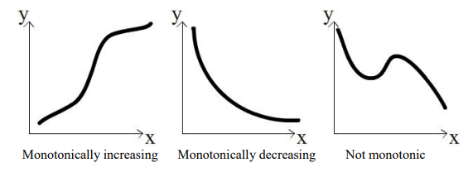
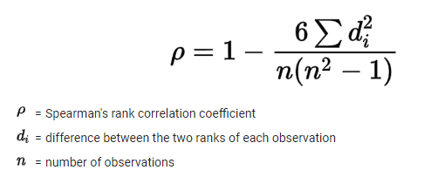
Feature Selection - Spearman Correlation
Spearman's correlation coefficient is the nonparametric version of the Pearson correlation, as there is no requirement of normality. It measures the strength and direction of the association between two ranked variables.
Spearman correlation can be used when the assumptions of the Pearson correlation are markedly violated. However, Spearman's correlation determines the strength and direction of the monotonic relationship between two variables rather than the strength and direction of the linear relationship between two variables, which is what Pearson's correlation determines.
A monotonic relationship is a relationship that does one of the following: (1) as the value of one variable increases, so does the value of the other variable; or (2) as the value of one variable increases, the other variable value decreases. Examples of monotonic and non-monotonic relationships are presented in the diagram below:
Internal

Slide 12
Feature Selection - Spearman Correlation
Connect input data to Select Columns in Dataset module.
Include only numeric columns as shown in diagram on the right.
Include also “is_canceled” to be used as Target Column.
Rejoin the columns later using Add Columns if required. The original order of rows is preserved.
Select Numeric Columns
Internal

Slide 13
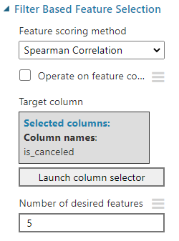
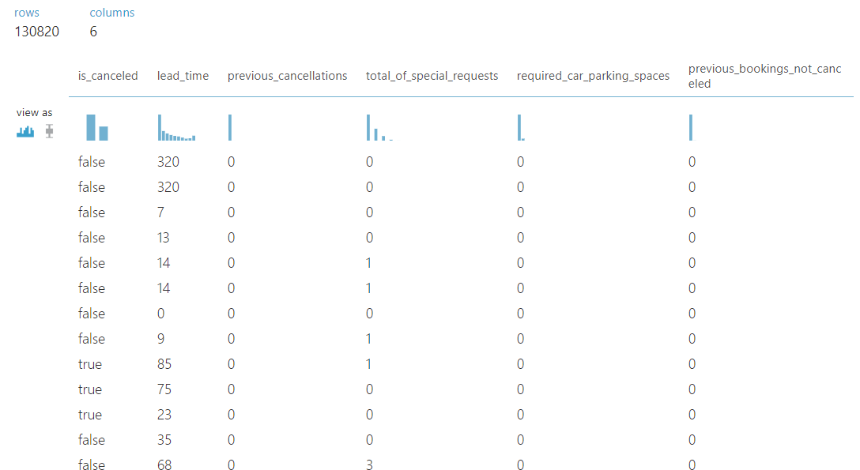
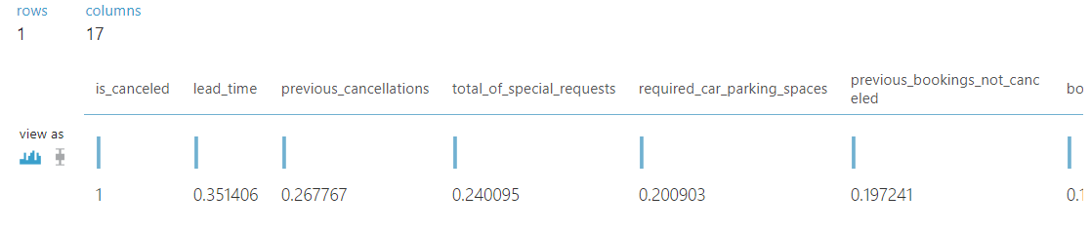
Feature Selection - Spearman Correlation
Connect to Filter Based Feature Selection module.
Select Spearman Correlation as Feature Scoring Method.
Click Launch column selector and choose one label as Target column, for example, “is_canceled”.
Type the number of columns for Number of desired features to indicate number of resultant features desired. For example, “5”:
If the specified number of desired features is greater than the number of columns in the dataset, then all features are returned, even those with zero scores.
If specify fewer result columns than there are feature columns, the features are ranked by descending score, and only the top features are returned.
Run the experiment and visualize results:
Returned dataset with Top 5 features based on descending coefficient.
Coefficient of all features with Target column.
Execute Spearman Correlation
Coefficient of all features with target, higher the better.
Dataset with top 5 features highly correlated to target
Internal

Slide 14


Feature Selection - Kendall Correlation
Also commonly known as “Kendall’s tau coefficient”, Kendall Correlation is used to access statistical associations based on the ranks of the data.
This is also the best alternative to Spearman correlation (non-parametric) when your sample size is small and has many tied ranks.
Kendall rank correlation is used to test the similarities in the ordering of data when it is ranked by quantities. It uses pairs of observations and determines the strength of association based on the patter on concordance and discordance between the pairs.
Concordant: Ordered in the same way (consistency).
A pair of observations is considered concordant if (x2 — x1) and (y2 — y1) have the same sign.
Discordant: Ordered differently (inconsistency). A pair of observations is considered concordant if (x2 — x1) and (y2 — y1) have opposite signs.
Kendall coefficient of correlation is usually smaller values than Spearman correlation. The calculations are based on concordant and discordant pairs. Insensitive to error. P values are more accurate with smaller sample sizes.
Internal

Slide 15
Feature Selection - Kendall Correlation
Connect input data to Select Columns in Dataset module.
Include only numeric columns as shown in diagram on the right.
Include also “is_canceled” to be used as Target Column.
Rejoin the columns later using Add Columns if required. The original order of rows is preserved.
Select Numeric Columns
Internal

Slide 16
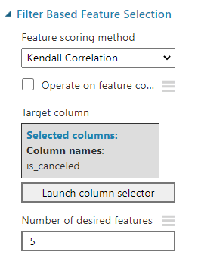
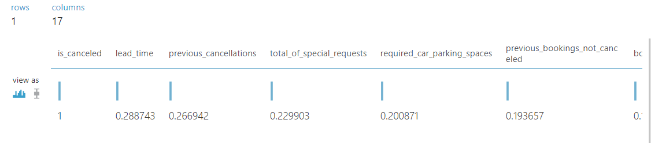
Feature Selection - Kendall Correlation
Connect to Filter Based Feature Selection module.
Select Kendall Correlation as Feature Scoring Method.
Click Launch column selector and choose one label as Target column, for example, “is_canceled”.
Type the number of columns for Number of desired features to indicate number of resultant features desired. For example, “5” :
If the specified number of desired features is greater than the number of columns in the dataset, then all features are returned, even those with zero scores.
If specify fewer result columns than there are feature columns, the features are ranked by descending score, and only the top features are returned.
Run the experiment and visualize results.
Returned dataset with Top 5 features based on a coefficient
Coefficient of all features with Target column
Execute Kendall Correlation
Coefficient of all features with target, higher the better.
Dataset with top 5 features highly correlated to target
Internal

Slide 17
Feature Extraction
Internal

Slide 18
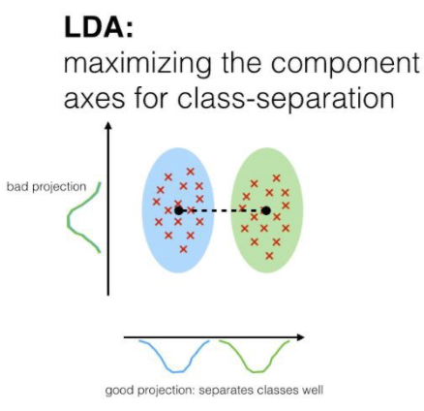
Feature Extraction - Linear Discriminant Analysis
Feature extraction is a process of dimensionality reduction by which an initial set of raw data is reduced to more manageable groups for processing. A characteristic of these large data sets is a large number of variables that require many computing resources to process.
Feature extraction is the name for methods that select and /or combine variables into features, effectively reducing the amount of data that must be processed, while still accurately and completely describing the original data set.
Linear Discriminant Analysis (LDA) is a supervised learning dimensionality reduction technique and aims to maximize the distance between the mean of each class and minimize the spreading within the class itself. LDA uses within classes and between classes as measures to maximize the distance between the means of each class when projecting the data in a lower-dimensional space, leading to better classification results.
When using LDA, it is assumed that the input data follows a Gaussian Normal Distribution, therefore applying LDA to not Gaussian data can possibly lead to poor classification results.
Source: Linear Discriminant Analysis
https://sebastianraschka.com/Articles/2014_python_lda.html
Internal

Slide 19
Feature Extraction - Linear Discriminant Analysis
Check input data meets the below criteria:
Data is as complete as possible. Rows with any missing values are ignored.
Data are expected to be normally distributed. Before using Fisher Linear Discriminant Analysis, examine the distribution and identify any outliers.
Remove any non-numeric columns. The algorithm will return an error if invalid numeric columns are included.
Connect input data to Select Columns in Dataset module.
Include only numeric columns as shown in diagram on the right.
Include also “is_canceled” to be used as Target Column.
Rejoin the columns later using Add Columns if required. The original order of rows is preserved.
Select Numeric Columns
Internal

Slide 20
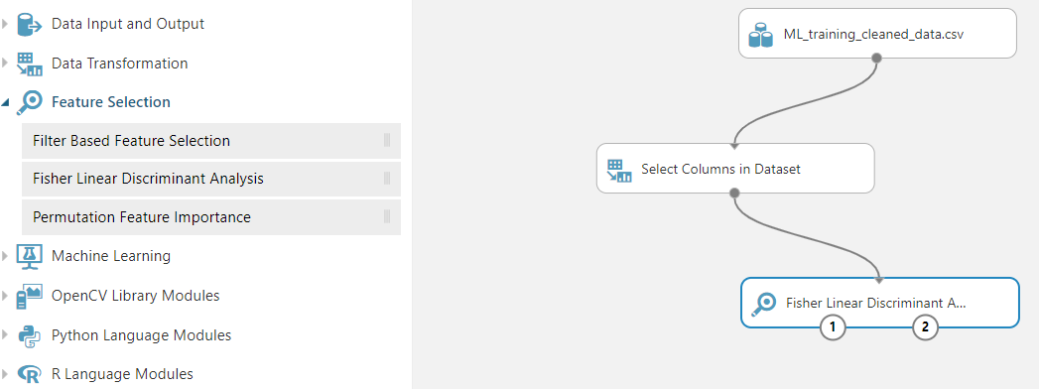
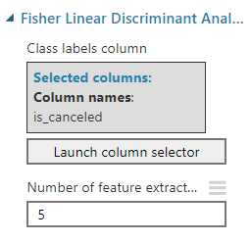
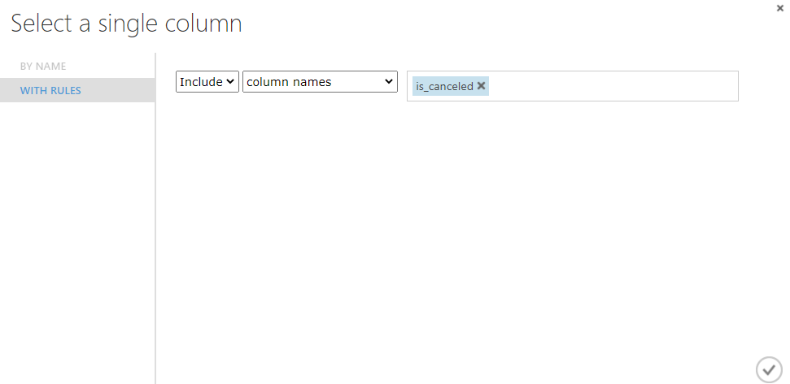
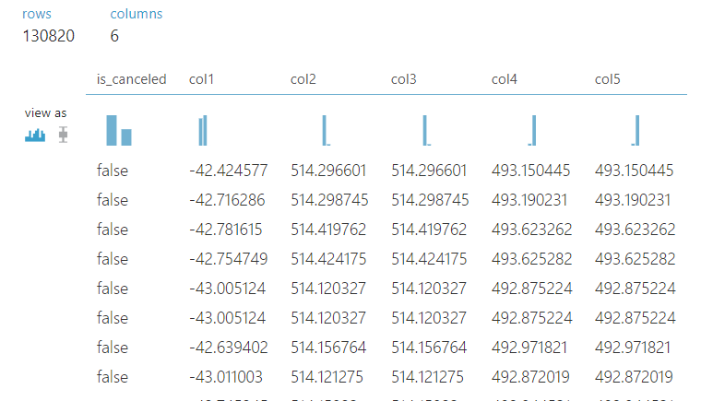
Feature Extraction - Linear Discriminant Analysis
Connect to Fisher Linear Discriminant Analysis module.
Click Launch column selector and choose one label as Class labels column, for example “is_canceled”.
Type the number of columns for Number of feature extractors to indicate number of resultant features desired. For example, “5” will collapse all numeric columns into a new, reduced feature space of only five columns.
Run the experiment and visualize the output.
The output of LDA is a reduced dimensions of 5 features datasets
Execute Linear Discriminant Analysis
Reduced to 5 features
Internal

Slide 21


Summary
Feature Selection
Pearson correlation, Chi-squared Test, Spearman Correlation, Kendall Correlation
https://docs.microsoft.com/en-us/azure/machine-learning/studio-module-reference/feature-selection-modules
https://docs.microsoft.com/en-us/azure/machine-learning/studio-module-reference/filter-based-feature-selection
Feature Extraction
Linear Discriminant Analysis
https://docs.microsoft.com/en-us/azure/machine-learning/studio-module-reference/fisher-linear-discriminant-analysis
Internal

Slide 22
Thank you for your passion!
Internal

